Slide 1

USED CAR PRICE PREDICTION PROJECT REPORT
ACKNOWLEDGMENT
SUBMITTED BY:
NASHEED ASAD

Slide 2
Table of contents
Introduction
Analytical Problem Framing
Model Building
Data Visualizations
Conclusion

Slide 3
INTRODUCTION
We have witnessed several changes in the automotive market as a result of the Covid-19's influence on the market. Some automobiles are in high demand, thus they are more expensive, while others are not, so they are less expensive. One of our clients does business with small traders that sell secondhand cars. With the market changing as a result of the Covid-19 effect, our customer is having issues with their prior automobile price valuation machine learning models. As a result, they are seeking for new machine learning models based on new data. We must create an automobile price valuation model.
The project's goal was to create a model that could forecast the price of used automobiles based on the available independent factors. This model may then be utilized by management to understand how the prices fluctuate in relation to the factors. As a result, they may alter the firm's strategy and focus on regions that will provide significant profits. Furthermore, the model will help management understand the price characteristics of a new market post covid.

Slide 4
ANALYTICAL PROBLEM FRAMING
Mathematical/Analytical Modeling of the problem
This is a Regression problem, and the final aim is to estimate used vehicle prices based on data. I gathered the data from cars24.com and will build the model using the information I gathered.
Data sources and their formats
The dataset has 8116 rows and 11 columns. Using this dataset, we will train the Machine Learning models on 75% of the data and test the models on 25% of the data.
The data was obtained in csv format from cars24.com. The data is described further down.

Slide 5
Brand | Brand of the car
Model | Model of the car
Variant | Variant of the car
Make Year | Manufacturing Year of the car
Fuel Type | Type of fuel used in the car
Transmission | Type of transmission of the car
Kilometers Driven | Number of KMs driven by the car
Owner | Number of previous owners
Location | Cars location
Price | Price of the car
Car Age | Age of the car

Slide 6
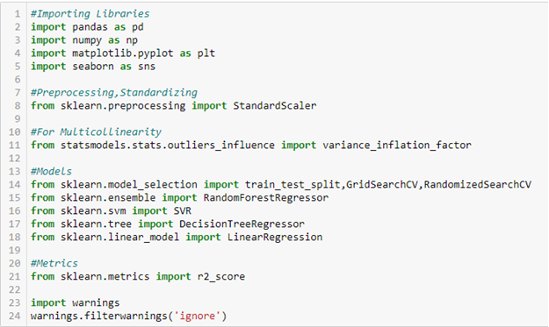
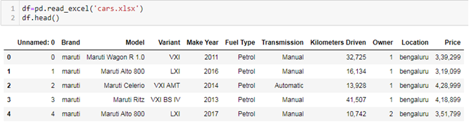
Data Preprocessing Done
Importing the required libraries and viewing a preview of the data.

Slide 7
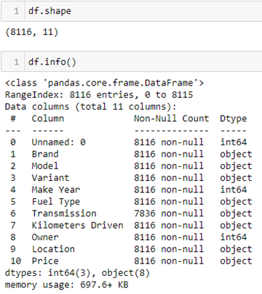
We can see there are 8116 rows and 11 columns. There are null values in the 'Transmission' column. We have int and object data types in our dataset. Price is our target variable.

Slide 8


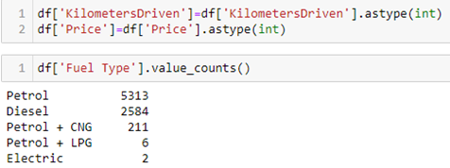
We have converted 'Kilometers Driven' and 'Price' variables into int data types. And we have dropped 'Unnamed: 0' since it gives no value to our dataset. We will do some data cleaning on our 'Fuel type', 'Model' and 'Variant' variables too.

Slide 9
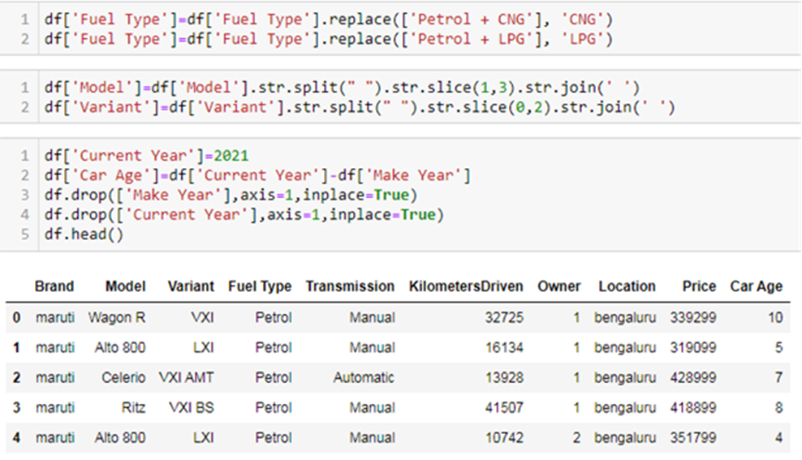
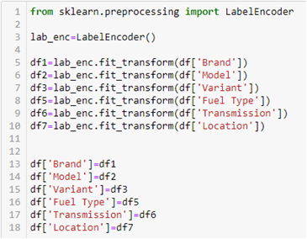
We will add a new variable 'Car Age' and delete the 'Make Year' variable.
We have converted categorical data into numerical data.

Slide 10
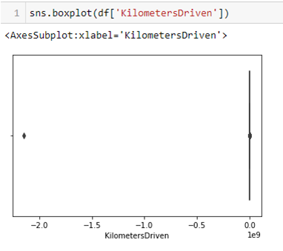
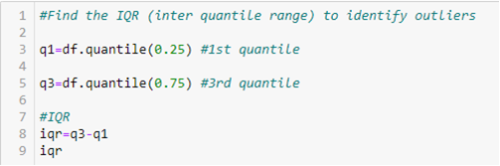
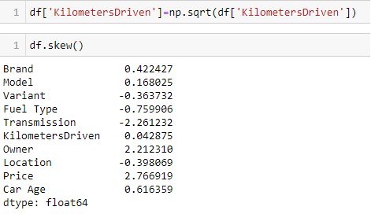

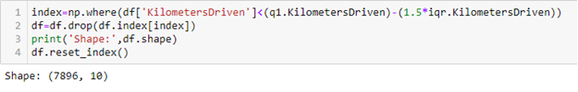
We have removed Outliers present in KilometersDriven which was the only numerical data in the original dataset. And then we have corrected the skewness of the variable too.

Slide 11

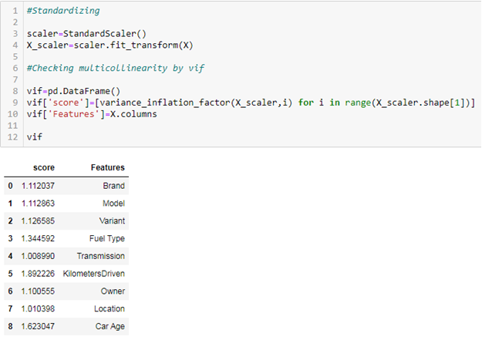
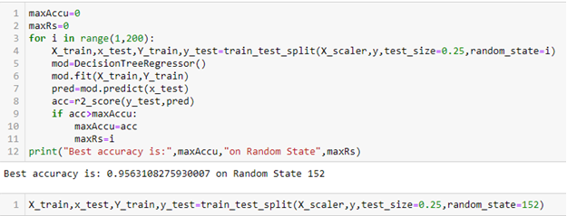
MODELS DEVELOPMENT AND EVALUATION
Separated dependent and independent variables.
Standardized and looked for multicolimearity. Found none.
Checked for best random state to find the best accuracy.

Slide 12
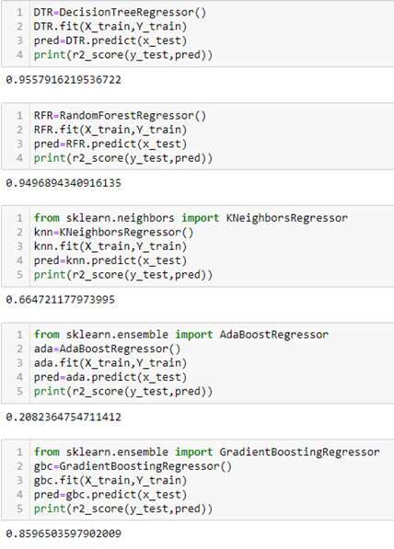
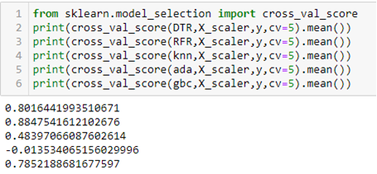
We have used 5 different algorithms to test our dataset:
Decision Tree Regressor: 96%
Random Forest Regressor: 95%
K-Neighbors Regressor: 66%
Ada Boost Regressor: 21%
Gradient Boosting Regressor: 86%
After performing cross validation, we find Random Forest Regressor as our best model as it gives the least difference between r2 score and cross validation scores.

Slide 13
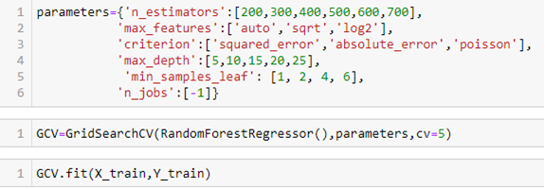
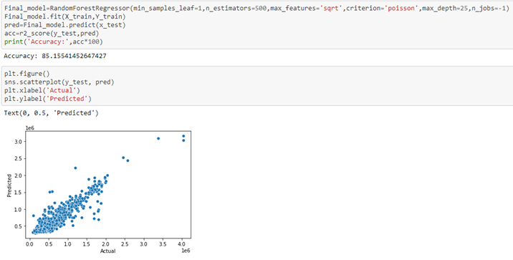
We have performed hyperparameter tuning on our best model to check if we can increase our accuracy. What we found is our model was over fitting since it gives a final accuracy of 85%.

Slide 14

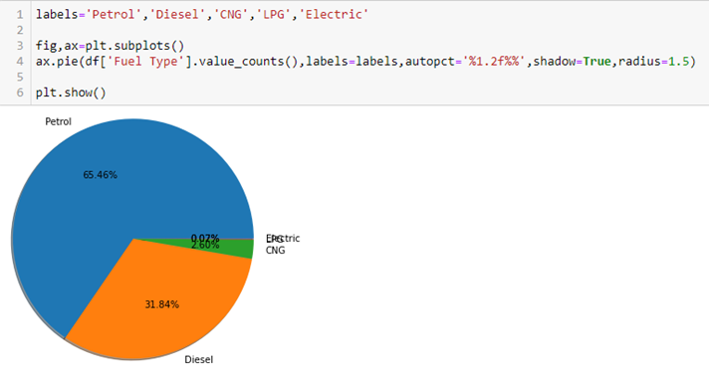
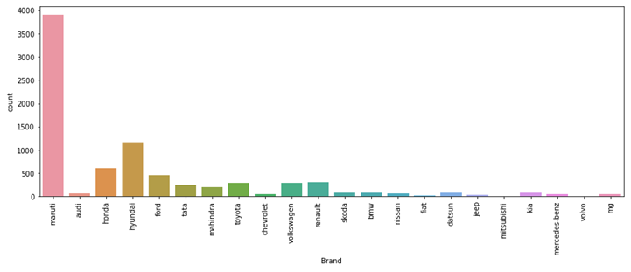
Maruti, Hyundai and Honda are the most sold cars.
Visualizations
Petrol engine cars are most sold followed by diesel engine and CNG.
Maruti, Hyundai and Honda are the most sold cars.

Slide 15
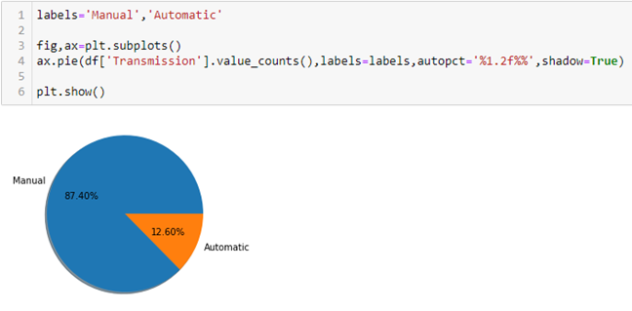

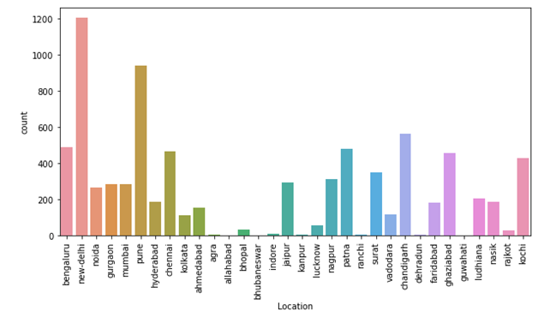
Manual Transmission cars are most sold.
States with most sold cars are New Delhi, Pune and Chandigarh.

Slide 16
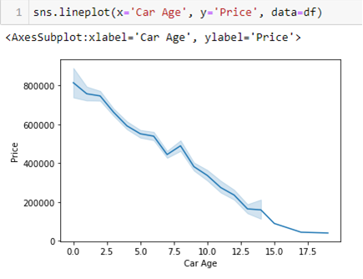
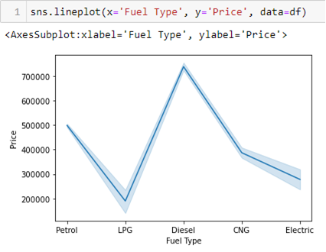
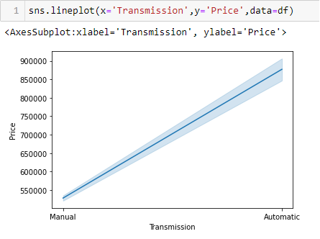
Car price decreases with increase in car age.
Diesel cars are sold at higher prices whereas LPG is sold at lower price.
Automatic cars are sold at higher prices as compared to manual cars.

Slide 17


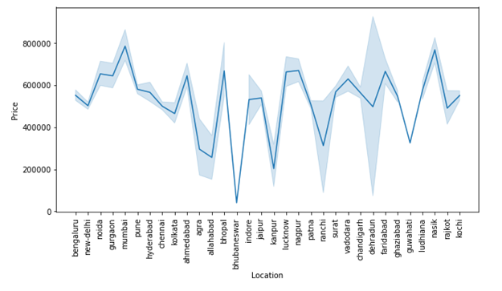
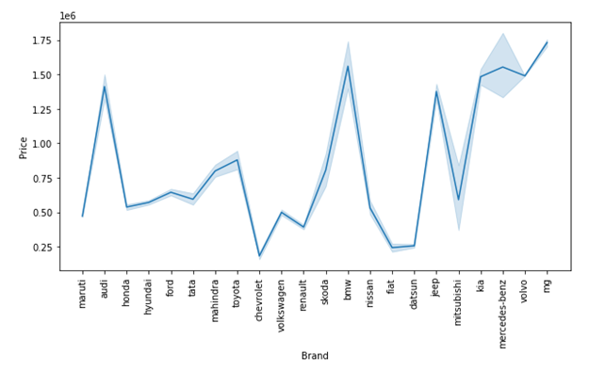
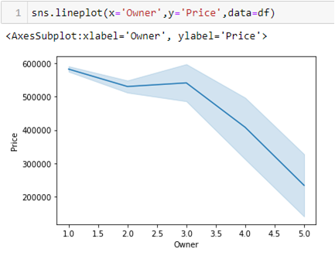
Car price decreases with increase in number of previous owners.
Cars in Mumbai, Nasik, Bhopal and Nagpur are sold at higher price whereas Bhubaneswar has the cheapest price for used cars.
Mg, BMW, Mercedes-benz are sold at higher price whereas Chevrolet, Fiat and Datsun are sold at lower price.

Slide 18
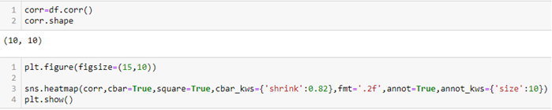
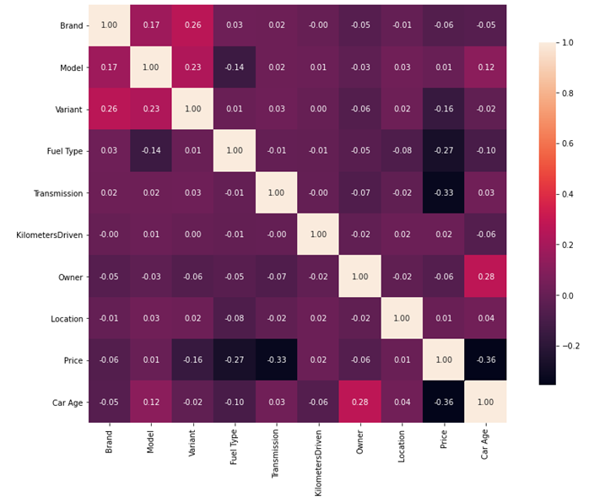
There is no multicolinearity issue in the dataset.

Slide 19
Conclusion
The data has been collected by scraping the website of CARS24. The data has been cleaned, analyzed, encoded and models based on different techniques have been built.
In this project, I sought to demonstrate how used vehicle prices change and what variables contribute to the fluctuation of automobile prices. The Random forest regressor model did a good job of forecasting prices.
Note:- The full details of the project can be found in this link: https://github.com/nasheedasad/Flip-Robo-Car-Price

Slide 20
Thank You

